Slide 1





DoctorSathi
Convenient Appointment Scheduling & EHR (Electronic Health Report Management) for Physicians and Patients in Nepal.
Capstone Project: Bimal Kandel
Youngstown State University
MCIS, CSCI 6991
@right reserved to Bimal Kandel

Slide 2


DoctorSathi: Main Goals
An inventive web application called “DoctorSathi” (Doctor as a friend in literal Nepali meaning) was created to overcome the communication gap between Nepali patients and healthcare professionals or providers.
With the lack of technological advancement in healthcare systems in Nepal, the system's main goal is to make healthcare more efficient by:
Allowing patients to schedule appointments quickly and easily to their local clinics/doctors.
Providing healthcare practitioners with safe storage for medical reports.
Enhancing accessibility for people in both rural and urban settings.
Using state-of-the-art technology to build a healthcare system that is more patient-friendly and efficient.

Slide 3

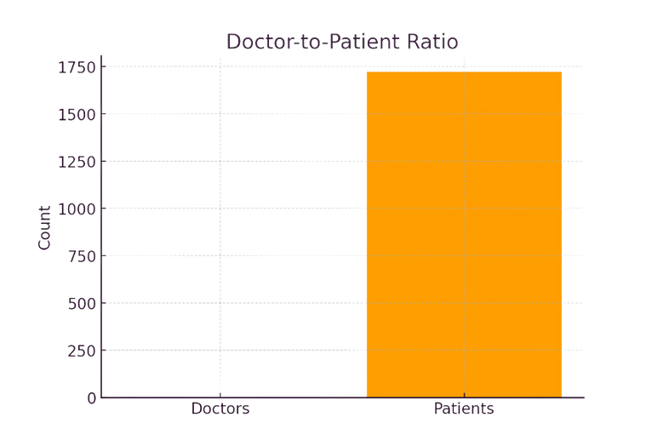
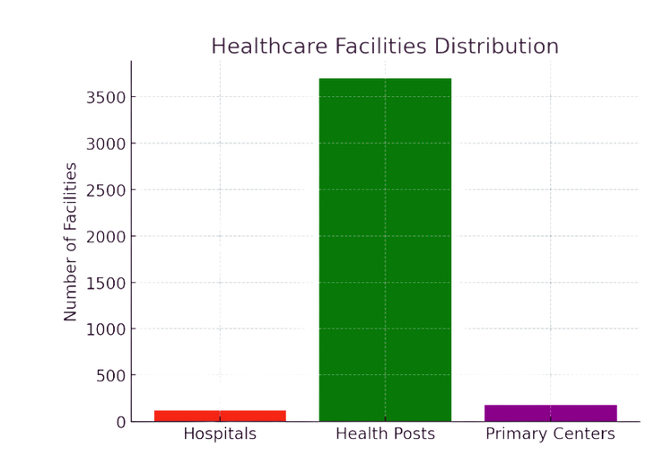
Health Care in Nepal: Overview
Nepal's healthcare system is a mix of public, private, and community health services.
Despite advancements, patients continue to encounter difficulties such as:
Lengthy wait periods in clinics and hospitals.
Restricted availability of professionals, especially in rural regions.
Ineffective report management methods that rely on paper.
Absence of easy access and digital access to Electronic Health Reports (EHR)
*Central Bureau of Statistics (CBS), Nepal,
**World Health Organization (WHO) and the Nepal Medical Council (NMC)
***Ministry of Health and Population (MoHP), Nepal, Annual Reports.

Slide 4
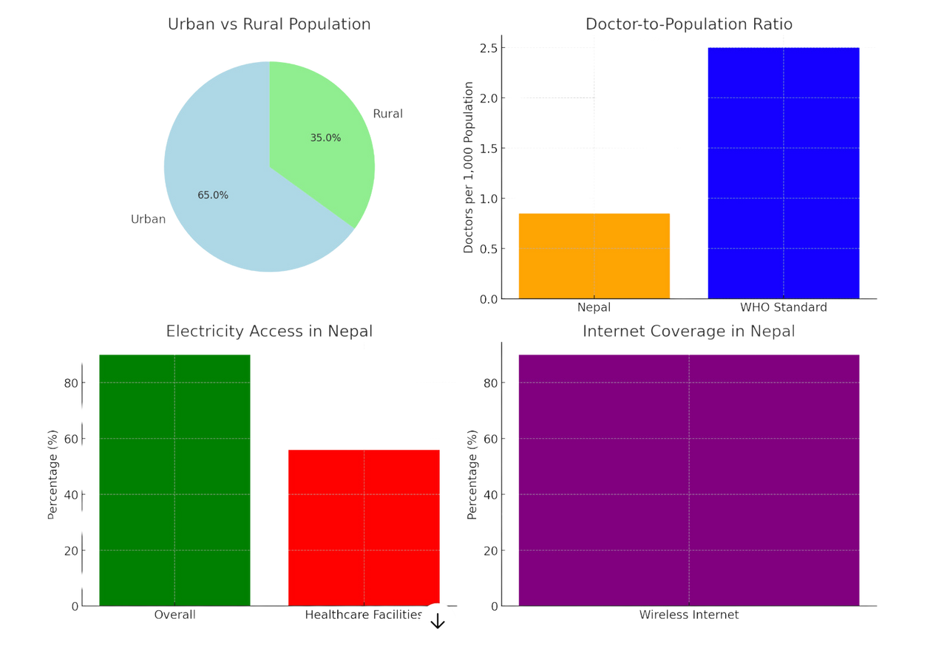
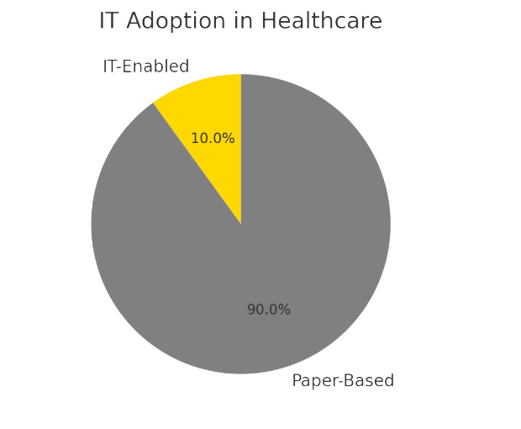
IT in Health Care in Nepal: Overview
Although it is still underutilized, IT adoption in healthcare is increasing.
Electronic health records (EHR), telemedicine, and mobile health apps are emerging trends in Nepal.
By providing a user-centric, digital solution for healthcare booking and report storage, DoctorSathi hopes to hasten this transition.

Slide 5








Inefficient Appointment Systems
Manual booking causes mistakes and delays.
Without a guarantee of consultation time, patients frequently travel great distances. thus resulting in overcrowding and inefficient services.
Poor Record Management:
Records on paper are vulnerable to destruction or loss.
The quality of care is impacted when patient history is not centrally accessible.
Accessibility Issues:
Problem Statement
Access to medical professionals and specialists is a problem in rural places. The doctor-to-patient ratio is 0.85 to 1000 people.
Challenges in Nepal's Healthcare System
Low Adoption of Technologies
Only 56% of healthcare facilities have dependable energy, even if 90% of them have wireless internet access.
Particularly in rural areas, there is a lack of knowledge and confidence in digital health tools like telemedicine and e-consultation services.
Lack of unified health system
There is currently no system for scheduling appointments that can link patients and physicians in various locations, which could result in

Slide 6


Relevance to the Project
Because of these difficulties, it is imperative to create "DoctorSathi," a centralized online system for scheduling appointments that will:
Close the communication gap between patients and medical professionals.
Simplify the scheduling procedure for patients and physicians.
Make use of Nepal's expanding IT infrastructure to improve the efficiency and accessibility of healthcare.

Slide 7




WorkFlow
Actors
Options: Log In / Register
Entry Point
Patient
Decision Node
Log in based upon user category e.g. Doctors, Users & Admin(clinics)
Doctors
Process Node
Patients: Search → Book Appointment → View EHR → Get Notifications
Process Node
Doctors: Manage Schedules→ Consult→ Update Records
Admin(clinics): Manage Users → Generate Reports
Admin
Exit
Log Out

Slide 8





Steps to Build DoctorSathi
extensive security and usability testing.
Requirement Gathering
Design & Development
Features
Testing & Deployment
Interfaces that are easy to use for both physicians and patients.
Secure technologies were used in the backend's construction to store data.
These two users are under admin control.
Appointment Booking: Real-time scheduling with doctors.
Report Saving: You can safely upload, read, and download reports.
Email and SMS reminders for forthcoming appointments are examples of notifications.
Extensive performance and usability testing.
Research and collect info about tech, healthcare systems, and data.
Contact and consult healthcare providers, pharmacies and Tech people in my networks
Identified Key issues with healthcare system.

Slide 9
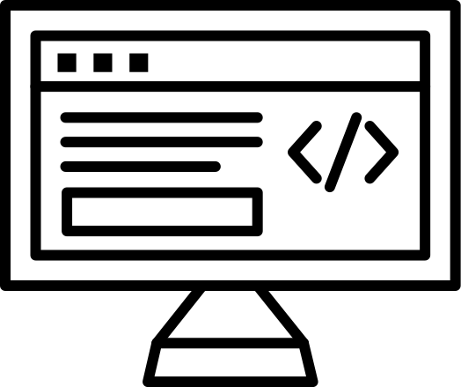


Development tools used
HTML5 ( structures of the contents)
CSS3 has been used to make web app visually appealing and responsive.
JavaScript and jQuery has been used to add interactivity, such as handling form validation or dynamically updating content.
Frontend
(Client-side)
Bootstrap is used to ensures that the application looks visually fit on various screen sizes (responsive design).
PHP, combined with CodeIgniter, is used to handle the application's logic, processes user input, and communicates with the MySQL database to fetch, store, or update data.
CodeIgniter's MVC structure organizes the application code efficiently.
Backend
(Server-side)
MySQL stores all the data in the webapp (e.g., user profiles, EHR) and retrieves it as needed by users, doctors, or admins.
Backend
(Server-side)

Slide 10


Key Experiments : Trial & Error
Developed simple interface for patients of all ages could use the interface easily and intuitively.
Gathered few users inputs for iterative enhancements.
UI INTERFACE
SYSTEM PERFORMANCE TESTING
Stress tests to handle high user volumes.
Database optimization for quick access to reports and appointment information
Adherence to Nepal's laws governing healthcare data
SYSTEM PERFORMANCE TESTING

Slide 11





Advantages of Dr. Sathi
Doctors are easily accessible, cutting down on wait times.
Streamlined administration of medical histories with safe report storage.
For Patients:
streamlined administration of medical histories with safe report storage.
Simplified time management and appointment scheduling for physicians.
Access of medical records of patients in order to improve care.
Optimise the health care practices and manage the flow and data for clinics and doctors
For Doctors/
Clinics(admin):
Bridges the gap between rural patients and urban healthcare providers.
Sets a foundation for broader IT adoption in healthcare.
For Nepal's Healthcare System in longrun

Slide 12




Challanges
Adoption in rural areas where digital literacy is low.
Ensuring internet connectivity in remote regions for seamless operation.
Inefficient IT Infrastructures
High cost of investment for IT health-related projects for hardware, software and training
Fragmanted health care system
No Standardized Health IT Policy
Resistant to change or adopt new technology
Lack of data protection laws
Risk of cyber securities
Language barriers ( English as secondary) language)

Slide 13





Steps to Overcome Challenges
Building capacity involves educating patients and healthcare professionals about digital tools.
Government support includes setting up explicit guidelines and setting aside funds for medical IT.
Public-Private Partnership Working together to create and manage IT systems with private businesses.
Localized solutions include low-tech environment optimization and platform design in local languages.

Slide 14




Conclusion
DoctorSathi is a start toward digital change in Nepal's healthcare industry, not just a booking system. DoctorSathi enables physicians/clinics and patients by tackling persistent problems including disjointed medical documentation and ineffective scheduling.
Prospects for the Future:
Inclusion of teleconsultation services in the expansion.
E-prescription integration with pharmacies.
AI-powered suggestions for individualized medical care.
DoctorSathi Mobile App for both Android and iOS users.

Slide 15




Thanks!

